Slide 1







Slide 2


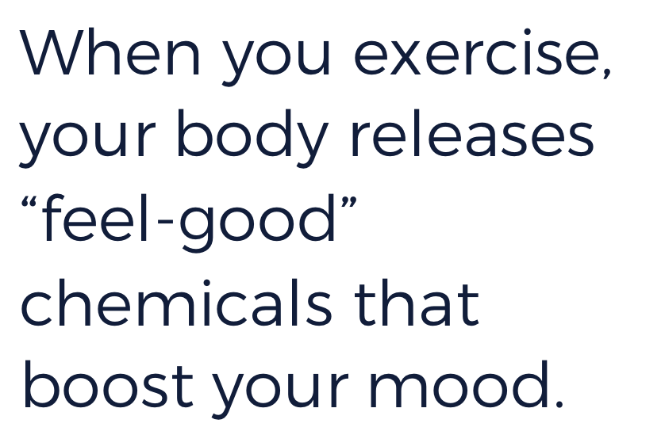

Notes:
Instructor Notes: Direct students to do an aerobic exercise in place for one minute and describe how they feel before and after doing it. Write these words in the “Before” and “After” columns of a T-Chart.

Slide 3




Notes:
Instructor Notes: Ask students to share activities that make them laugh and describe how they feel after laughing. Write these words in the “After” column of the T-Chart.

Slide 4




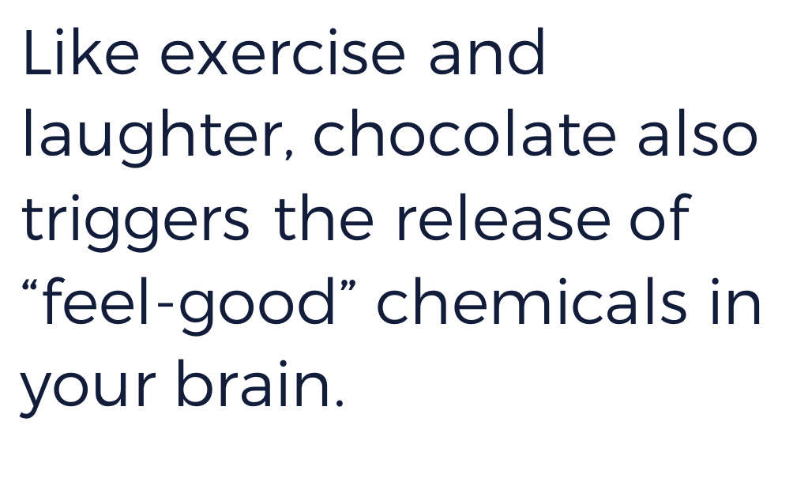

Notes:
Instructor Notes: Prior to class, determine whether anyone has a food allergy or dislikes chocolate so that you can prepare something else for these students to eat. Distribute a small piece of chocolate to each student, and ask them to describe how they feel after eating it. Write these words on the “After” column of the T-Chart.
Connect the three activities in first three slides. Then, ask students to brainstorm other activities that might release the body’s “feel-good” chemicals.

Slide 5

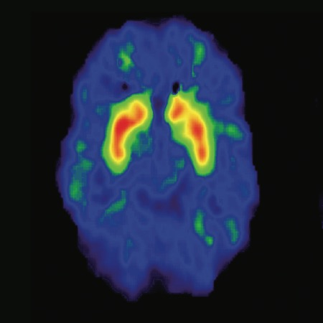
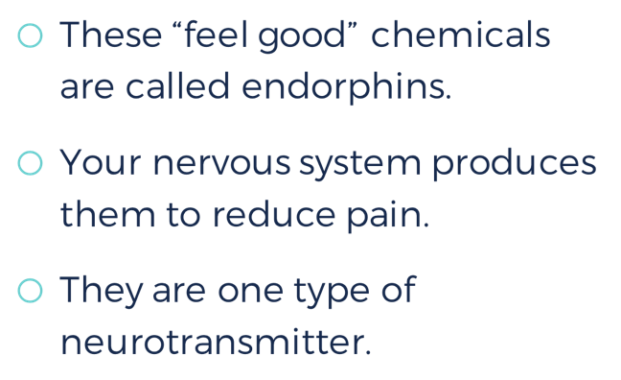

These “feel good” chemicals are called endorphins.
Your nervous system produces them to reduce pain.
They are one type of neurotransmitter.
Notes:
Instructor Notes: Click to reveal the image first, and discuss what students see and what they think is happening. Then, click to reveal the text and define endorphins.

Slide 6

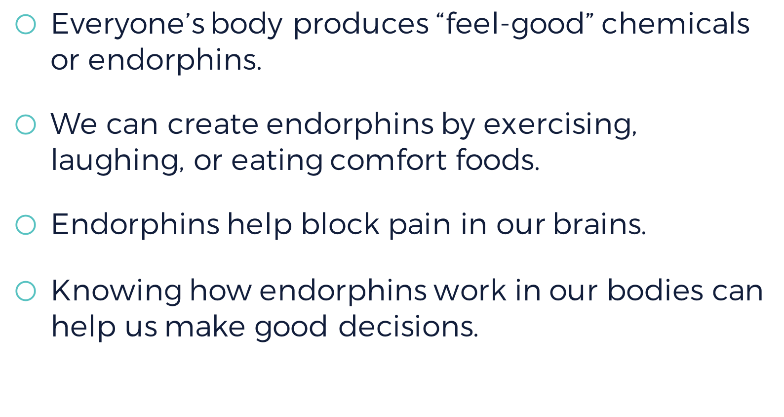

Everyone’s body produces “feel-good” chemicals or endorphins.
We can create endorphins by exercising, laughing, or eating comfort foods.
Endorphins help block pain in our brains.
Knowing how endorphins work in our bodies can help us make good decisions.

Slide 7


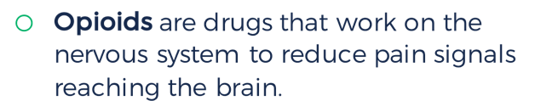
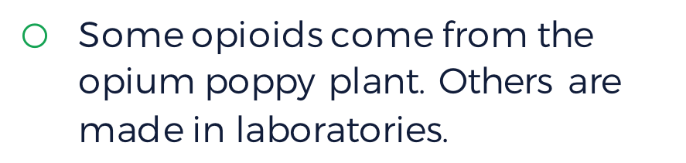
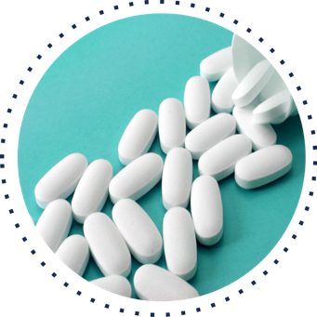
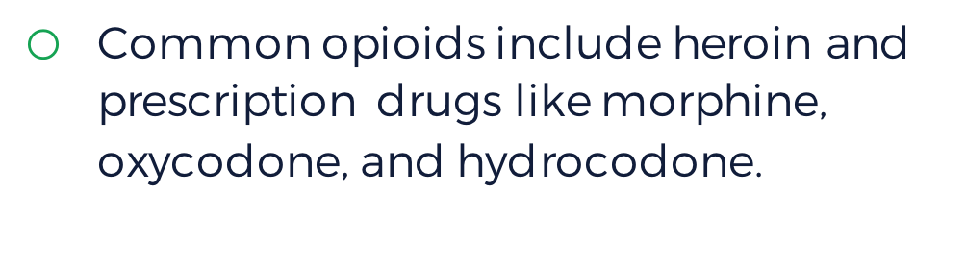

Opioids are drugs that work on the nervous system to reduce pain signals reaching the brain.
Some opioids come from the opium poppy plant. Others are made in laboratories.
Common opioids include heroin and prescription drugs like morphine, oxycodone, and hydrocodone.
Notes:
Instructor Notes: Click to reveal the image and then each bullet point of text, and discuss each with students before moving on to the next one.
When people take opioid drugs, they experience a euphoric rush because these drugs also affect the brain regions involved in reward. Some people may misuse opioids because they want to intensify their experience by taking the drug in ways other than those prescribed. Some people don’t use opioids to control pain. They use opioids because it gives them a relaxed, “high” feeling.

Slide 8




opioids
endorphins

Slide 9


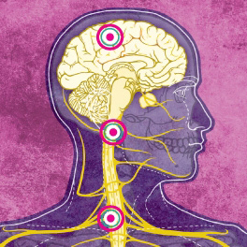



Notes:
Instructor Notes: In small groups, students should read the linked article, take notes on a separate sheet of paper, and then discuss the questions. As a whole class, share out small-group responses.

Slide 10
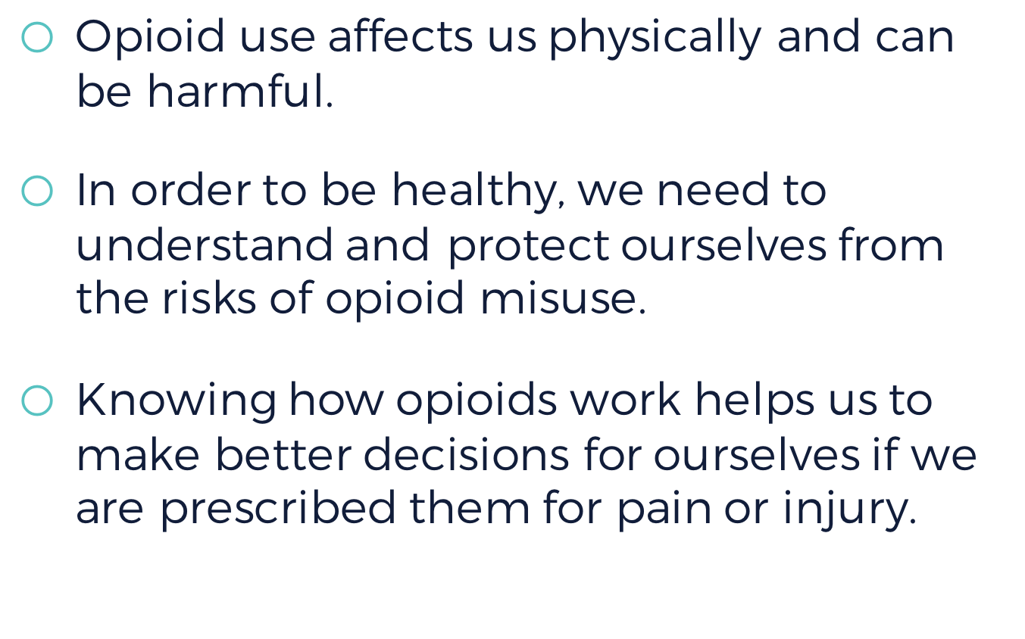

Opioid use affects us physically and can be harmful.
In order to be healthy, we need to understand and protect ourselves from the risks of opioid misuse.
Knowing how opioids work helps us to make better decisions for ourselves if we are prescribed them for pain or injury.

Slide 11

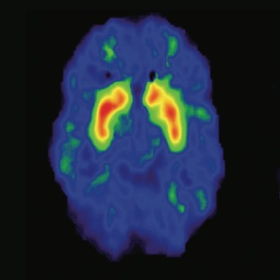
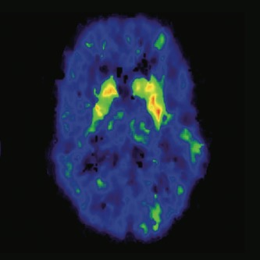


What questions do you have?
Notes:
Instructor Notes: As they view the image, students should note how the brains are different: the left side shows normal activation of the brain during a cognitive task. The right side shows brain activation with the influence of drugs. Activation is shown by color: red shows strongest activity, then orange, then yellow, then green. The image on the left shows strong activation in red and orange in the target area, while the image on the right shows much less and weaker activation, with only a little yellow and green.

Slide 12

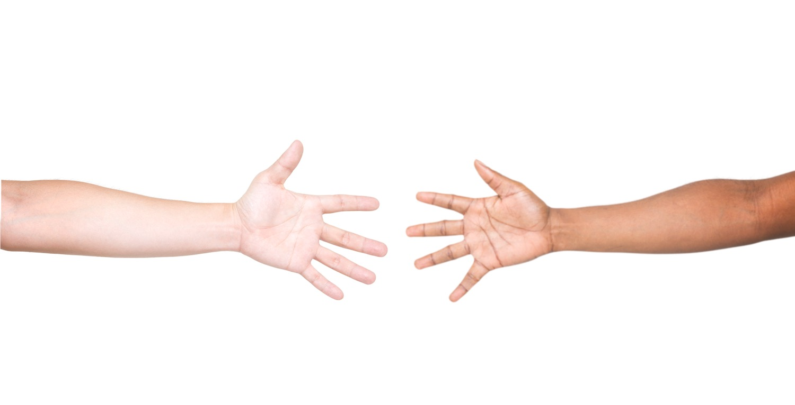

Notes:
Instructor Notes: Conduct the activity described in the Educator Guide.
1. Direct students to stand around the room, a little more than an arm’s-length apart. They should not be able to touch each other.
2. Ask: How can we send a message from student to student using our arms and fingers only?
3. Students should try to extend their arms and spread their fingers to send signals like sign language. Encourage other creative ways to send a message using only their arms and fingers.
4. See if students can point out a drawback of this model. (There isn’t a direct connection between students.) This will segue into the purpose of neurotransmitters.

Slide 13

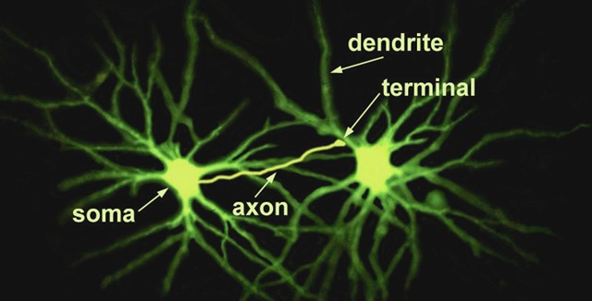

Notes:
Instructor Notes: Describe how neurons are composed of several parts: the soma (cell body), dendrites (branches), and an axon (fibers) leading to a terminal (bulb). Point to each part in the diagram. Make connections, or encourage students to do so, between their body parts in the previous model activity and the neuron. (The body is the soma, the arm is the axon, and their fingertips are the terminal.) Then, ask students to predict what each part of a neuron does.
Once students have had a chance to explore the image, explain the purpose of each part. The branches (dendrites) receive messages from neighboring neurons. The middle (soma) processes the information. It creates an electrical signal (a major impulse called the action potential) and sends it down the fiber (axon) toward the bulb at the tip (terminal); the signal can then be transferred to the dendrites of a neighboring neuron. Use your finger or the onscreen pointer to trace this movement on the slide.
It is more important for students to understand the purpose of the parts, and the direction that a message moves relative to each part, than to memorize the names of each part.

Slide 14


Notes:
Instructor Notes: After watching this video, students should be able the explain the five main steps in the process of neural transmission. You may wish to pause the video frequently for students to take notes as they complete the activity in the Educator Guide, or plan to watch the video several times as a class.
https://science360.gov/obj/tkn-video/0e2ab299-9dfe-4cad-b517-85ad949a67db/mysteries-brain-thinking-brain

Slide 15

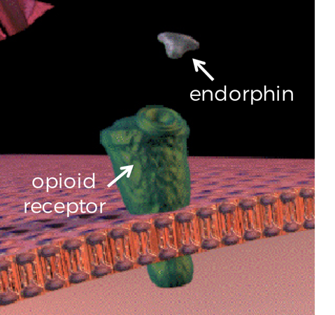
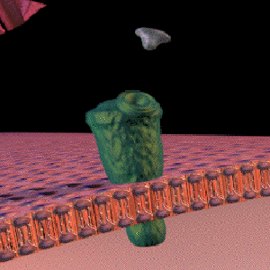
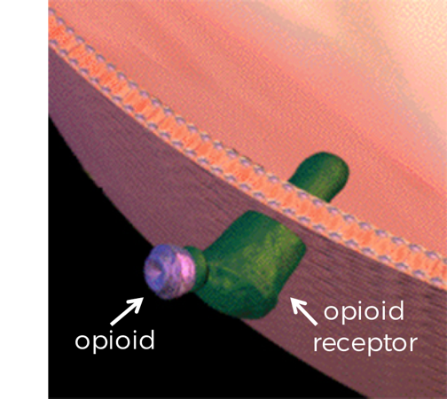
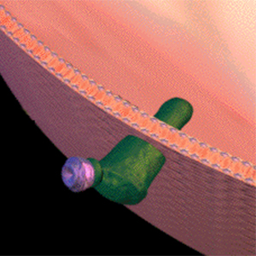
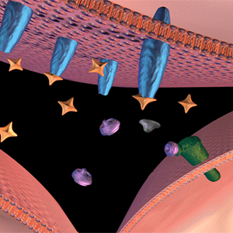


The brain cannot tell the difference!
endorphin
opioid receptor
opioid receptor
opioid
Notes:
Instructor Notes: Present students will this analogy: neurotransmitters are like “keys” that fit certain “locks” in the brain. Different keys fit different locks. Because the shapes of opioids and endorphins are similar, opioids are able to fit into “locks” intended for endorphins.
Click to display the images and ask students a series of questions to guide their inquiry:
What do you notice about the shape of each “key”—i.e., the natural endorphin and an opioid like morphine? (Circle the bottom section of each—i.e., the section that fits into the endorphin receptors. They are similar.)
The endorphin receptor is the “lock” from the analogy. What type of “lock” does each key fit into? (Both natural endorphins and opioid receptors fit into endorphin receptors.)
What conclusion can you draw from this relationship? (The brain cannot tell the difference between natural endorphins and opioids.)
After students have drawn their own conclusions, explain that opioids mimic the action of endorphins by fitting in the same locks (binding to endorphin receptor sites in the brain). This affects feelings of pain as well as a person’s overall emotional state. However, endorphins are not harmful or addictive like opioid drugs are. Endorphins come from positive activities such as exercising, laughing, and eating certain foods. Click the slide to display the text (“The brain cannot tell the difference!”).

Slide 16
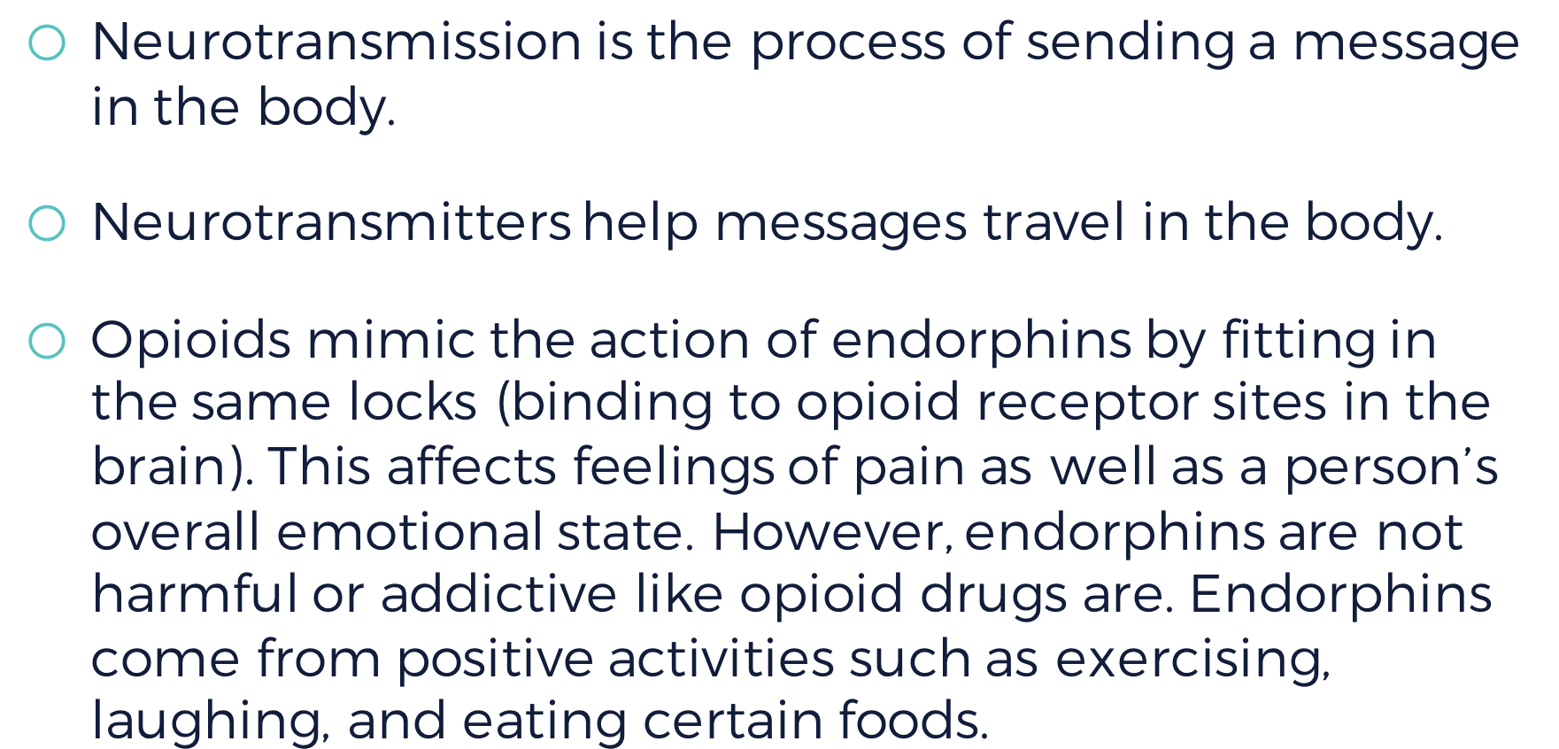

Neurotransmission is the process of sending a message in the body.
Neurotransmitters help messages travel in the body.
Opioids mimic the action of endorphins by fitting in the same locks (binding to opioid receptor sites in the brain). This affects feelings of pain as well as a person’s overall emotional state. However, endorphins are not harmful or addictive like opioid drugs are. Endorphins come from positive activities such as exercising, laughing, and eating certain foods.

Slide 17

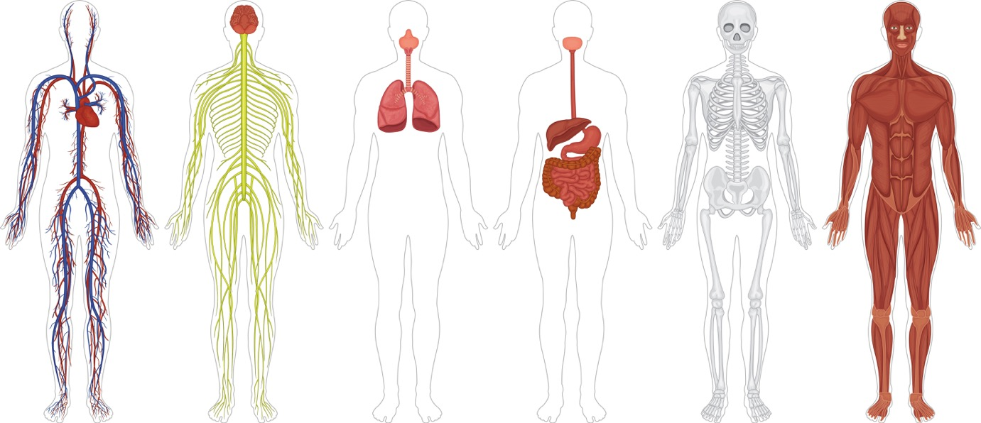







Circulatory
Nervous
Respiratory
Digestive
Skeletal
Muscular
Notes:
Instructor Notes: Display the images of the body systems before displaying the text labels. Ask students to reflect on how each body system functions in a healthy person. If time allows, each student should write a six-word description of each system.

Slide 18


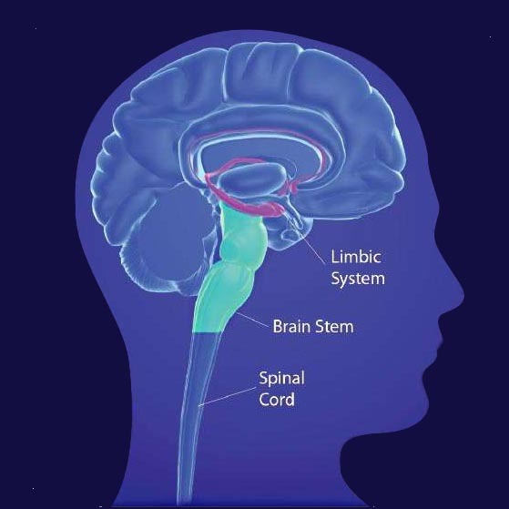










Dry mouth
Heavy feeling in fingers and toes
Vomiting
Severe itching
Notes:
Instructor Notes: Students should be able to identify the short-term effects on the nervous system (euphoria), circulatory system (slowed heart function), respiratory system (slowed breathing), digestive system (dry mouth, nausea, vomiting), muscular system (warm flushing of the skin, heavy feeling in fingers and toes, itching), and skeletal system (bone thinning). Connect these short-term effects to the brain and nervous system by interacting with the image and saying the following:
“Opioids can slow breathing by altering activity in the brainstem (point to this section), which controls automatic body functions such as breathing and heart rate.”
“Opioids can increase feelings of pleasure by altering activity in the limbic system (circle this system), which controls emotions.”
“Opioids can block pain messages transmitted through the spinal cord (draw an arrow up along this section) from the body.”

Slide 19

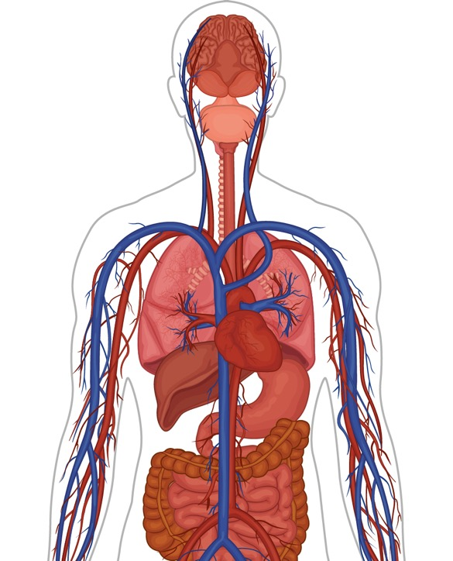














Nervous system
Integumentary system
Respiratory system
Circulatory system
Digestive system
Circulatory system
Notes:
Instructor Notes: Students should be able to identify the long-term effects on the circulatory system (infection of heart, collapsed veins), respiratory system (pneumonia), digestive system (decreased liver function), and nervous system (tolerance, dependence).

Slide 20

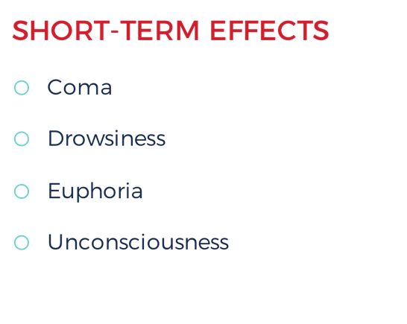
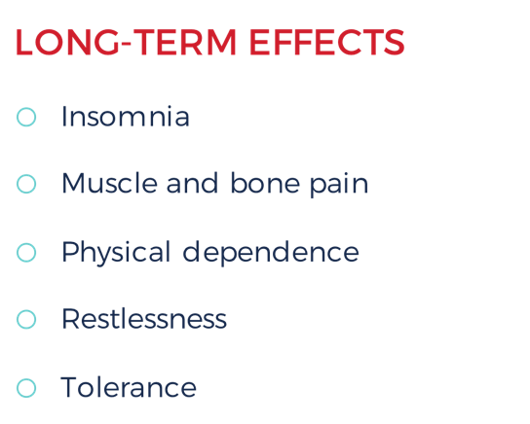


Overdose
Notes:
Instructor Notes: Ask students to imagine how a person would feel if they experienced endorphin rushes every day, multiple times per day. What would happen to the way they feel? If students have misconceptions, ask if they have ever eaten several spicy things back to back. Does the food taste less spicy over time?
Click to display this table and review each effect. Focus on physical dependence and tolerance.
Then, click to display the text below the table. Explain that an overdose is when someone takes too much of a drug and the body starts to shut down, sometimes leading to death. Overdoses are common with opioid misuse because many prescription drugs are very strong and it is difficult to determine the right amount.

Slide 21
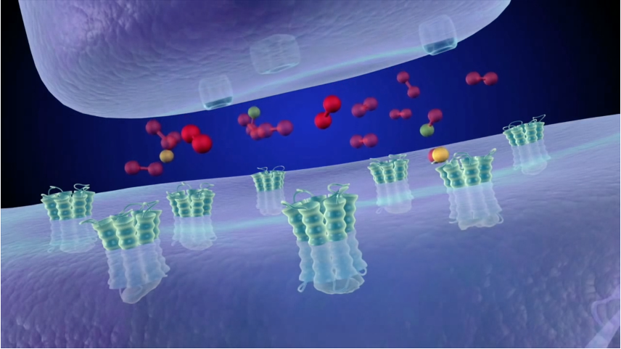


Notes:
Instructor Notes:
Watch the 2018 Virtual Field Trip, Opioids: Real People. Real Stories. Real Science.
https://www.operationprevention.com/virtual-field-trip

Slide 22

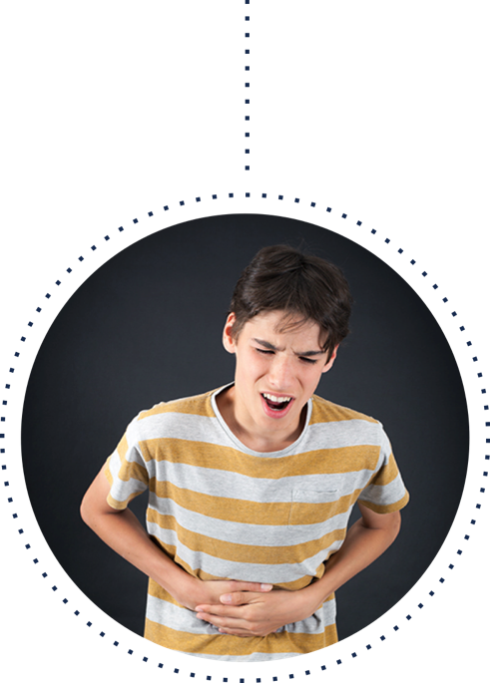
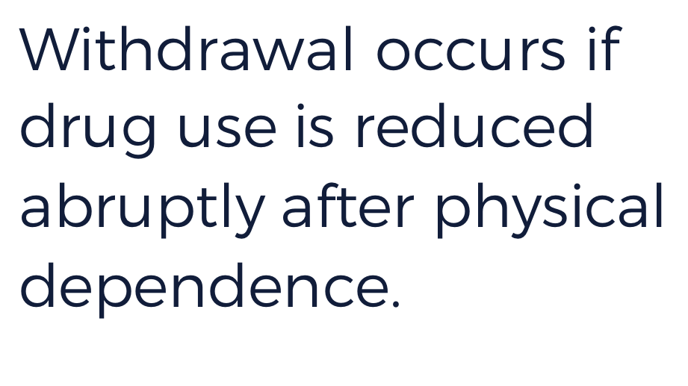
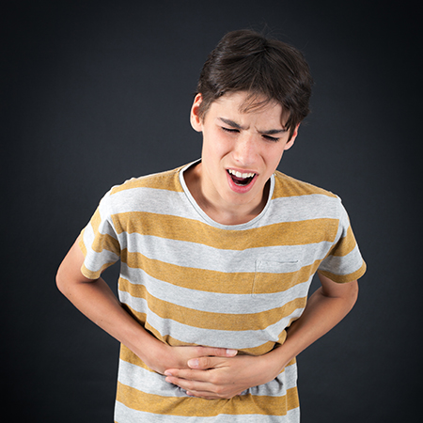
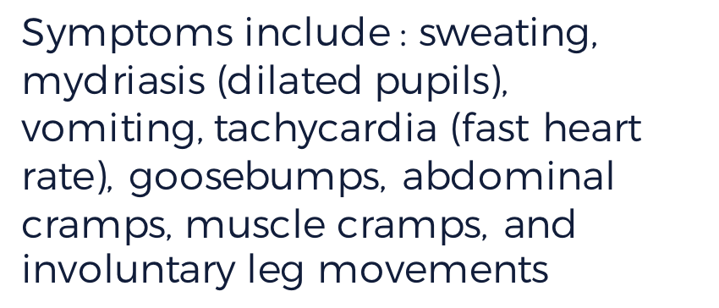

Symptoms include : sweating, mydriasis (dilated pupils), vomiting, tachycardia (fast heart rate), goosebumps, abdominal cramps, muscle cramps, and involuntary leg movements
Notes:
Instructor Notes: Ask students if they have any routines (like brushing their teeth every morning) and how their bodies would feel if this routine were interrupted. Click to display the definition of withdrawal. Then, click to display the image and ask students to describe what they see.

Slide 23


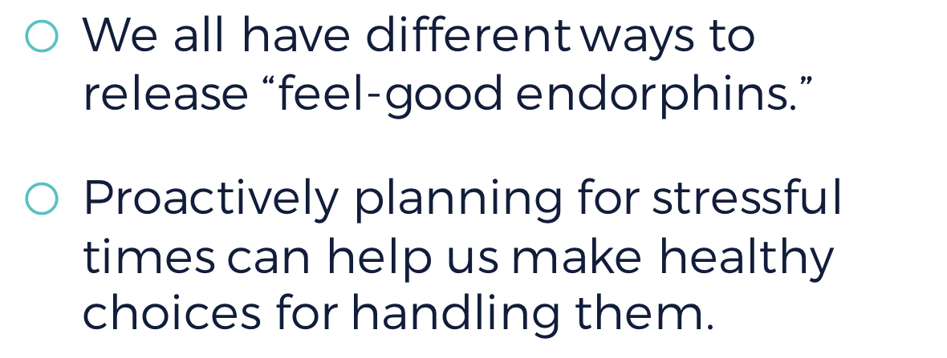


Slide 24

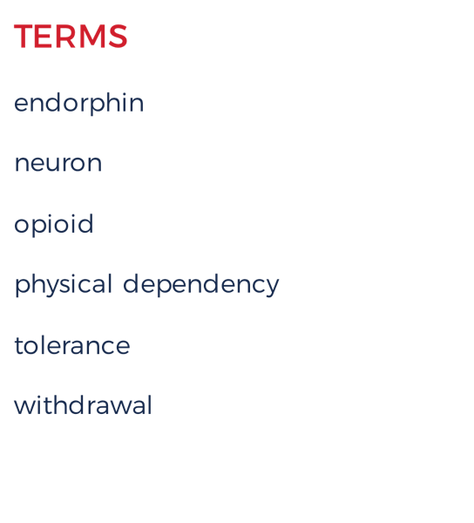
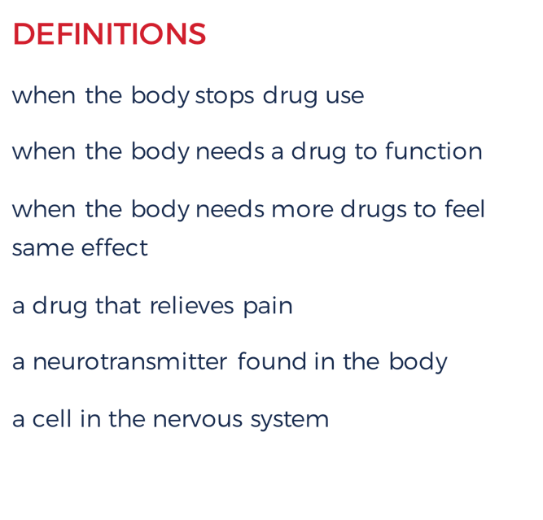

Notes:
Instructor Notes: Instruct students to match each key term on the left with its definition on the right. Then, display the correct answers.

Slide 25

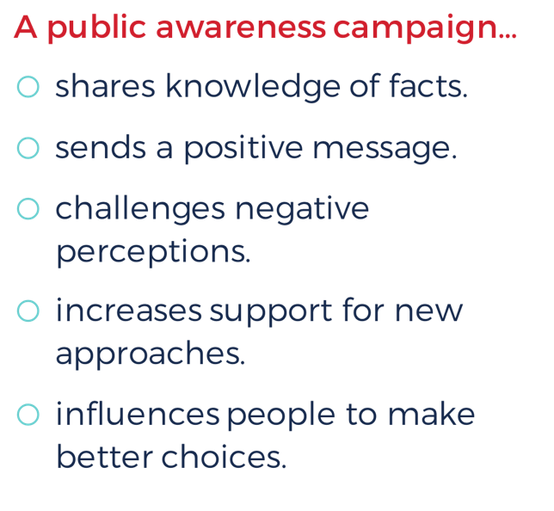



Notes:
Instructor Notes: Click to display the definition of public awareness campaign, and review with students to make sure everyone understands what a campaign is. Then, click to display possible topics. You may wish to provide an example for each topic.

Slide 26









Choose one idea you learned in this lesson about opioid misuse.
1
Decide how your social media campaign will communicate the science of opioid misuse.
2
3
Write a hashtag.
4
Create an example post.
5
Submit this post to your teacher.
Notes:
<PRODUCTION NOTES: Animate each step to appear one at a time.>
Instructor Notes: You may wish to present these instructions one at a time so that all students are completing the same step simultaneously. This will help you answer any questions about a particular step for the entire class.

